Slide 1
Project WorkSheet→

Slide 2
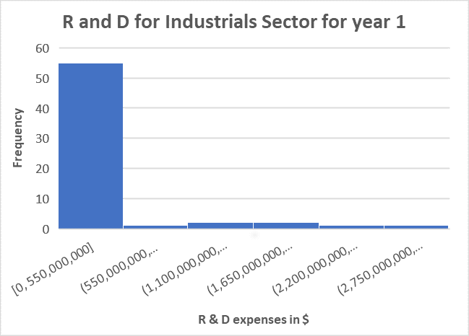
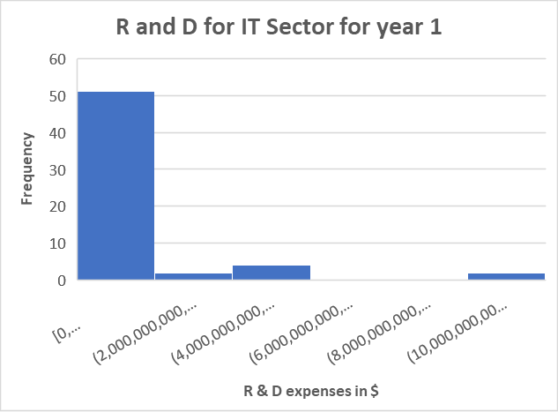
Does the Industrials sector have similar expenditure levels for Research and Development than Information Technology sector in Year 1?
Here are the histograms for the annual R&D expenses for Industrials and IT sector companies reported for all companies in Year 1.
Both distributions are right-skewed or positively skewed. That means, the mean for each is higher than the median.
The mean for Industrials is about $222 million, and for IT is slightly above $1.2 billion.
However, the median for IT is $590 million and the median for Industrials is $0.
The standard deviation for IT is also slightly more ( $202 billion for IT and $618 million for industrials companies). That means, the variability in R&D expenses for IT companies is higher, with more companies spending above $10 Billion , and more than 50% of the IT companies spending more than $590 million that year on R&D expenses.
Notes:
<visualization or summary statistics used for finding>

